Slide 1
Term End Project |
Project Title – Covid 19 public health data for Seattle & King county
Santosh Kumar Sinha [21355457]
BELLEVUE UNIVERSITY : DS530 Data Exploration and Analysis

Slide 2

Project Agenda
Project dataset dataset
A PowerPoint presentation outlining your statistical question/hypothesis
A minimum of 5 variables in your dataset used during your analysis (for help with selecting, the author made his selection on page 6 of your book). Consider what you think could have an impact on your question – remember this is never perfect, so don’t be worried if you miss one (Chapter 1).
Describe what the 5 variables mean in the dataset (Chapter 1).
Include a histogram of each of the 5 variables – in your summary and analysis, identify any outliers and explain the reasoning for them being outliers and how you believe they should be handled (Chapter 2).
Include the other descriptive characteristics about the variables: Mean, Mode, Spread, and Tails (Chapter 2).
Using pg. 29 of your text as an example, compare two scenarios in your data using a PMF. Reminder, this isn’t comparing two variables against each other – it is the same variable, but a different scenario. Almost like a filter. The example in the book is first babies compared to all other babies, it is still the same variable, but breaking the data out based on criteria we are exploring (Chapter 3).
Create 1 CDF with one of your variables, using page 41-44 as your guide, what does this tell you about your variable and how does it address the question you are trying to answer (Chapter 4).
Plot 1 analytical distribution and provide your analysis on how it applies to the dataset you have chosen (Chapter 5).
Create two scatter plots comparing two variables and provide your analysis on correlation and causation. Remember, covariance, Pearson’s correlation, and Non-Linear Relationships should also be considered during your analysis (Chapter 7).
Conduct a test on your hypothesis using one of the methods covered in Chapter 9.
For this project, conduct a regression analysis on either one dependent and one explanatory variable, or multiple explanatory variables (Chapter 10 & 11).
Your code or screenshots of your code
A 250-500-word paper summarizing the following: Statistical/Hypothetical Question
Outcome of your EDA
What do you feel was missed during the analysis?
Were there any variables you felt could have helped in the analysis?
Were there any assumptions made you felt were incorrect?
What challenges did you face, what did you not fully understand?
Submit a link to your repository to the assignment link during the final week of class.

Slide 3

Project Title – Covid 19 public health data for Seattle & King county
The project data set is created based on the outbreak of novel coronavirus (COVID-19) and various data collected by the public health department on Seattle and king county summarizing the COVID-19 epidemic in King County at multiple geographic levels (geo_id, population, week_start, week_end, case_count, hosp_count, death_count, total_hosp_incidental, pcr_test_count, pcr_test_pos_count, pcr_test_pos_percent) on time scales weekly starting from 12/29/2019 to 5/14/2023.
The Variables has been referring to the CDC information depicting the COVID status in the various King County communities. The dataset (8000 plus rows) is populated using an automation scripts.
During the pandemic Centers for Disease Control and Prevention (CDC) was tracking and analyzing the COVID-19 data to project insights into the spread, impact, and severity of the virus, how the PCR test was conducted and overall impact of PCR test to find Covid positive cases versus Hospitalization cases.
The data set has approx. 8000 rows and it indicates the trends, patterns, and hotspots, helping public health officials make informed decisions regarding interventions, mitigation strategies, and resource allocation.
The dataset prepared is just a sample and does not represent the actual CDC data for King county. Only the column names are referenced to simulate the pandemic data for a given period of time when the pandemic was at peek.

Slide 4
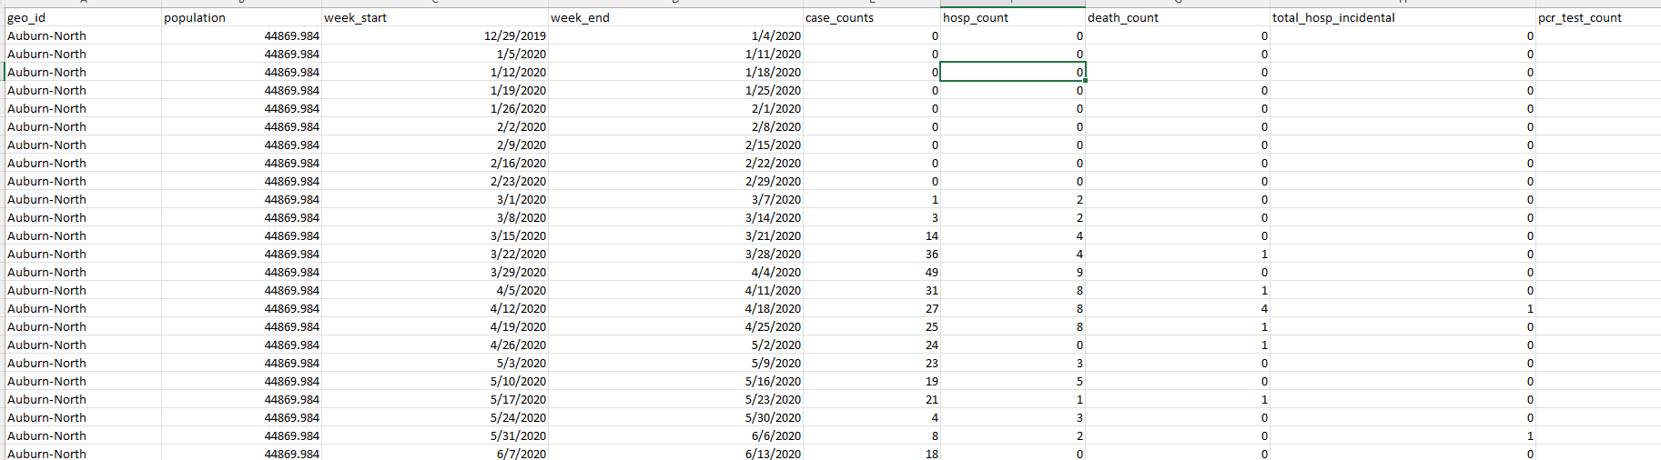
Project Title – Covid 19 public health data for Seattle & King county
Project Dataset

Slide 5
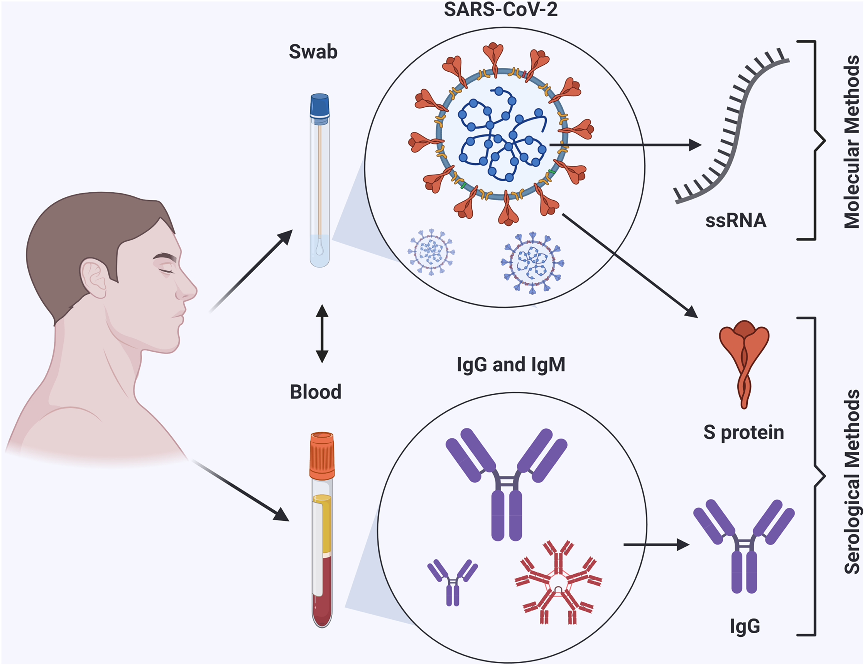
Covid 19 data set collection methods
The Centers for Disease Control and Prevention (CDC) was tracking the spread of the COVID-19 virus through various surveillance systems and data collection methods. Some of the method includes
Case Reporting: I this mechanism the State and local health authorities informs the CDC about confirmed COVID-19 cases. These reports provide details on those who have tested positive for the virus, including their demographics, symptoms, and any hospitalizations or fatalities that may have been brought on by them.
Testing Data: In this case the data on COVID-19 testing is gathered by the CDC, including the quantity of tests performed, the testing capacity, and the proportion of positive test findings. This data aids in tracking the virus's transmission and evaluating the accessibility and efficacy of testing.
Contact Tracing: This technique involves identifying and monitoring individuals who have been in close contact with someone infected with COVID-19. The CDC supports state and local health departments in their contact tracing efforts to track potential transmission chains and prevent further spread of the virus.
Syndromic Surveillance: In the Syndromic Surveillance technique the CDC tracks information from emergency rooms, urgent care clinics, and other healthcare institutions to identify trends and patterns in symptoms linked to COVID-19. This facilitates early outbreak detection and guides public health measures.
Seroprevalence Studies: It involve testing blood samples to determine the presence of COVID-19 antibodies in a population. These studies help estimate the proportion of people who have been infected with the virus, including those who may have had mild or asymptomatic cases.
Genomic Surveillance: In order to follow the genetic variants of the virus, the CDC performs genomic sequencing on COVID samples. This make it easier to spot novel variations, follow their distribution any possible effects, and keep an eye on any possible effects they could have on transmission, severity, and vaccination efficacy.

Slide 6
The project data set key Indicators
Some key indicators in the sample Covid 19 Project Dataset includes
Population: The population represents an essential factor when analyzing COVID-19 data set. The population of a particular area helps provide context and calculate rates that are important for understanding the impact and severity of the virus. Also, by considering population, we can gain a more comprehensive understanding of the impact of COVID-19 within a specific community or region.
Week Start and Week End : The Week Start and Week End acts as a key indicator to analyze the COVID-19 project dataset on a weekly basis. By using this key indicator public health officials and researchers can identify a trends, patterns, and changes in the spread and impact of the pandemic. This information is very crucial for implementing timely interventions, monitoring the effectiveness of control and safety measures, and informing public health policies and guidelines. the week start and week end dates are important indicators used to track trends and changes over time. Here's how these indicators can be helpful:
Weekly Case Counts: Using the weekly case counts Tracking the number of new COVID-19 cases reported within a specific week allows for the identification of trends and patterns. By comparing case counts from one week to another, public health officials and researches can determine if there is an increase, decrease, or stabilization in the number of infections.
Weekly Testing Data: To monitor the number of COVID9 tests getting conducted during a specific week. provides an insights into testing efforts and overall capacity. By comparing the testing data from week to week, helps researchers to determine if testing rates are increasing or if changes in testing strategies are impacting the number of positive cases getting detected.
Weekly Positivity Rates: By calculating the percentage of positive COVID tests out of the total tests conducted within a week, helps researches to get insight into the level of virus transmission. Tracking weekly positivity rates also helps to identify changes in the spread of the virus and informs decision-making on public health interventions.
Weekly Hospitalizations: A weekly count of COVID related hospitalizations can be used to estimate the strain on the healthcare system. It gives information on the seriousness of illnesses and the need for medical supplies and critical care facilities.
Weekly Deaths: The effect of the virus on mortality rates may be determined by keeping track of the number of COVID-related fatalities that are reported each week.The analysis of weekly death data enables the identification of spikes in mortality and the evaluation of the efficiency of public health interventions in lowering mortality.

Slide 7
The project data set key Indicators
Geo Id: In the context of the COVID project dataset, the GeoId refers to a geographical identifier or code assigned to a specific region, such as a country, state, or province. It is used to uniquely identify and classify different geographical areas within the dataset. Additionally, by utilizing GeoId’ s in a COVID project dataset, researchers and organizations can organize and analyze data based on different geographical regions to monitor the spread of the virus, track cases, and make informed decisions about public health interventions.
Case Counts: It represents the number of confirmed COVID cases in King County, which helps monitor the overall spread of the virus. Additional in the context of a COVID project dataset refer to the number of confirmed cases of COVID positive cases reported in a specific geographic area or region. It represents the total number of individuals who have tested positive for the virus in a particular location within a given time period. The Case counts can be further categorized based on different variables, such as daily new cases, cumulative cases, cases per population, cases by age group or gender, etc. These counts provide valuable insights into the progression of the pandemic and aid in making informed decisions to mitigate its impact.
Hospitalization count: It shows the number of people hospitalized due to COVID-19, including severe cases requiring intensive care. This information helps assess the strain on the healthcare system and the severity of the illness. The Hospitalization Count in a COVID-19 project dataset refers to the number of individuals who have been admitted to hospitals due to COVID-19. It represents the total count of patients who required hospitalization for medical care and treatment related to COVID-19. Additionally, it is also important for assessing the severity and impact of the virus on individuals and healthcare systems. It helps in monitoring the capacity and strain on hospitals, evaluating the need for additional resources such as beds, ventilators, and healthcare personnel, and understanding the overall burden on the healthcare system.
Death Counts: The number of COVID-19-related deaths in King County provides a measure of the virus's impact on mortality rates. It also refers to the number of confirmed deaths attributed to COVID in a specific geographic area or region. It represents the total count of individuals who have died as a result of COVID-19 infection within a given time period. Additionally, the Death counts can be further analyzed based on different variables, such as daily new deaths, cumulative deaths, deaths by age group or gender, deaths in specific settings (e.g., hospitals, nursing homes), and comorbidities. These counts provide crucial insights into the progression and consequences of the COVID-19 pandemic, aiding in decision-making processes and resource allocation for public health measures and healthcare systems.

Slide 8
The project data set key Indicators
Total Hospitalization Incidental : Its an indicator which refers the number patients primarily being hospitalized and for other issues are tested positive with COVID -19 virus as well. This types of exceptional cases may get lost by the reporting agencies and researcher; hence it is important factor to include this indicator while preparing the sample data for COVID -19
PCR Test Counts: The number of tests conducted, the percentage of positive tests, and the testing capacity in the county. This data helps understand testing availability and the rate of infection in the community. the "PCR test counts" in the context of COVID-19 project dataset refers to the number of Polymerase Chain Reaction (PCR) tests conducted to detect the presence of the SARS-CoV-2 virus, which causes COVID-19. PCR tests are one of the primary diagnostic tools used to identify active infections of the virus. The PCR tests work by amplifying and detecting the genetic material (RNA) of the virus in a patient's sample, usually collected from respiratory secretions (such as nasal swabs or throat swabs). The test counts represent the total number of PCR tests performed within a specific geographic area or time period.
PCR Test Pos Counts: To track the PCR test positive counts is crucial for assessing the prevalence and spread of the virus in a community or region. It helps in understanding the number of active cases, monitoring the positivity rate (the proportion of positive tests among total tests conducted), and identifying areas with higher transmission rates. The "PCR test positive counts" in the context of COVID-19 refers to the number of PCR tests that yield a positive result for SARS-CoV-2, indicating an active infection with the virus. These counts represent the total number of individuals who have tested positive for COVID-19 through PCR testing within a specific geographic area or time period. Also, by analyzing PCR test positive counts over time, public health officials can track the progression of the pandemic, assess the effectiveness of preventive measures, identify hotspots, and implement targeted interventions such as contact tracing and isolation measures
PCR Test Pos Percent : The “PCR Test Pos Percent”, also known as PCR Test Positive Percentage, is a metric used to assess the proportion of positive Polymerase Chain Reaction (PCR) tests among the total number of PCR tests conducted for COVID-19. It is an important indicator for public health officials to evaluate the effectiveness of testing strategies, understand the impact of interventions, and make informed decisions regarding containment measures and resource allocation. This metric also helps in monitoring the prevalence and spread of COVID-19 within a population or a specific geographic area. It provides insights into the positivity rate and helps gauge the level of transmission in a given community. A higher PCR Test Pos Percent indicates a higher proportion of positive cases among the tested population, suggesting a higher level of virus circulation.

Slide 9
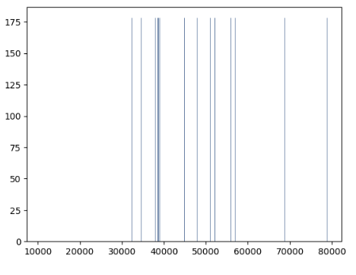
Population variable
The mode value for population field is : 78898.798
The mean value for population field is : 4.649316254032113
The Variance for population field is : 0.025804121890675498
The Standard Deviation for population field is : 0.16063661441488206
The Histogram representing the city population

Slide 10
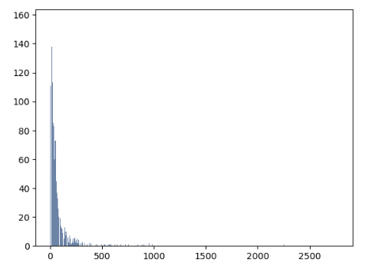
Case Count Variable
The mode value for case counts field is : 12.0
The mean value for case counts field is : 1.5141903613221528
The Variance for case counts field is : 0.2852145992307345
The Standard Deviation for case counts field is : 0.5340548653750236
The Histogram representing the case counts per week for COVID 19 virus.

Slide 11
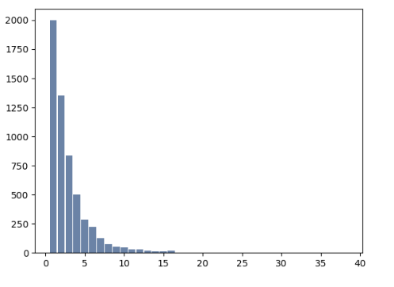
Hospitalization Count Variable
The mode value for hospital counts field is : 1.0 The mean value for hospital counts field is : 0.33973196165850716
The Variance for case counts field is : 0.09798849056791993
The Standard Deviation for case counts field is : 0.31303113354412515
The Histogram representing the Hospitalization counts per week data for COVID 19 virus.

Slide 12
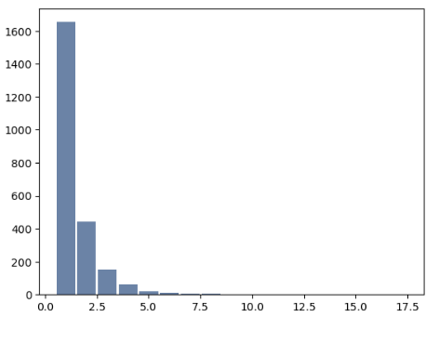
Death Count Variable
The mode value for death counts field is : 1.0
The mean value for death counts field is : 0.11898302316964746
The Variance for death counts field is : 0.04024787871340793
The Standard Deviation for death counts field is : 0.20061873968652064
The Histogram representing the Death Counts per week for COVID 19 Virus.

Slide 13
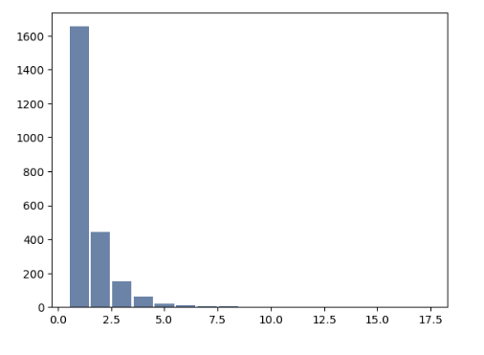
PCR Test count variable
The mode value for pcr test counts field is : 1.0
The mean value for pcr test counts field is : 0.11898302316964746
The Variance for pcr test counts field is : 0.04024787871340793
The Standard Deviation for pct test counts field is : 0.20061873968652064
The Histogram representing the PCR Test Counts per week for COVID 19 Virus.

Slide 14
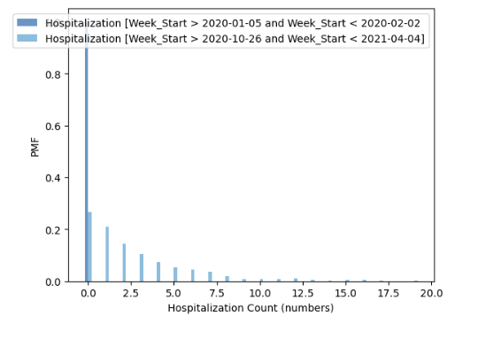
PMF Data – Scenario 1
Scenario 1: To compute the distribution of hospitalization counts for COVID-19 pandemic data for [Week_Start > 2020-01-05 and Week_Start < 2020-02-02] and [Week_Start > 2020-10-26 and Week_Start < 2021-04-04] and then plot the PMFs on the same scale
The graph indicates the start of the week 2020-01-05 has high hospitalization rates as compared to the following weeks.
Towards the end of the week 2021-04-04 the hospitalization rates due to the spread of COVID-19 is comparatively lower than the early weeks of virus spread.
The graph also shows that hospitalization rates decreased significantly at the conclusion of the pandemic

Slide 15
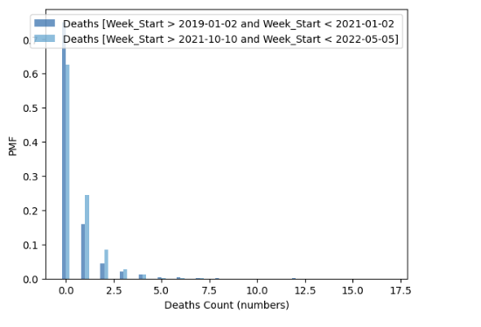
PMF data – Scenario 2
Scenario 2: compute the distribution of death counts data due to COVID-19 pandemic for [Week_End > 2019-01-02 and Week_End < 2021-01-02] and [Week_End > 2021-10-10 and Week_End < 2022-05-05] and then plot the PMFs on the same scale
During the starting week of 2019-01-02, the death rates were high.
During the initial phases of the pandemic the death rate were significantly high, and the death rates gradually decreased significantly at the conclusion of the pandemic

Slide 16
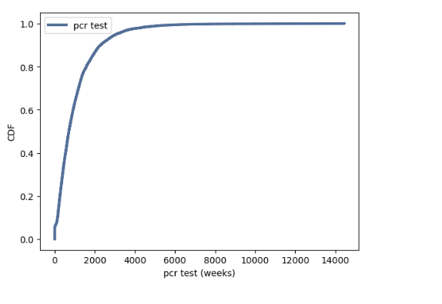
CDF Data on PCR Test Variable
Create 1 CDF with one of your variables, using page 41-44 as your guide, what does this tell you about your variable and how does it address the question you are trying to answer (Chapter 4).
Cdf provides ‘Prob’, which evaluates the CDF; that is, it computes the fraction of values less than or equal to the given value. For example, 14% of pcr test are less than or equal to 41.
print("cdf prob percentage :", cdf.Prob(200))
Cdf value evaluates the inverse CDF; given a fraction, it computes the corresponding value. For example, the median is the value that corresponds to 0.6.
print("cdf values :", cdf.Value(0.6))
The data are actually from a normal distribution, as shown by the accompanying PCR Test variable CDF graph, which also shows that the plot is roughly straight.

Slide 17
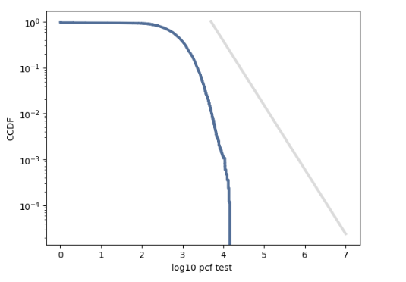
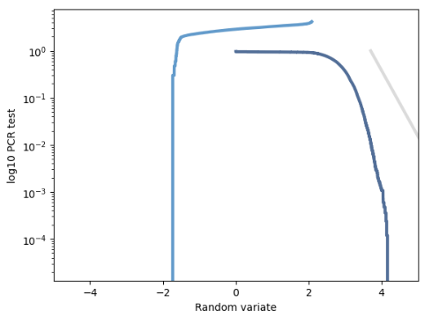
Analytical distribution using the Pareto model
Plot 1 analytical distribution and provide your analysis on how it applies to the dataset you have chosen (Chapter 5).
Here's the distribution of PCR Test conducted on the King County COVID 19 dataset in the U.S., along with a Pareto model. The model fits the data well in the tail. In the middle of the pandemic, the number of tests being run in the outset displays straight and higher numbers, and it progressively falls off at later phases.
The lognormal model might be a better fit for this data (as is often the case for things that are supposed to be Pareto).

Slide 18
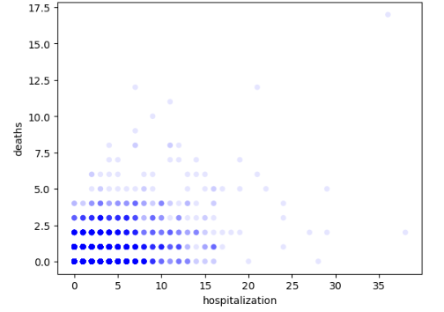
Scatter plots
Create two scatter plots comparing two variables and provide your analysis on correlation and causation. Remember, covariance, Pearson’s correlation, and Non-Linear Relationships should also be considered during your analysis (Chapter 7).
The scatterplot shows a weak relationship between the variables.
Plotting percentiles of hospitalization versus deaths suggests that the relationship is non-linear. The hospitalization increases more quickly in the range of hospitalization counts from 5 to 15. After that, the effect is weaker.
The scatterplot also indicates the mortality rates of the COVID 19 virus were higher in the range of hospitalization counts from 0 to 15.

Slide 19
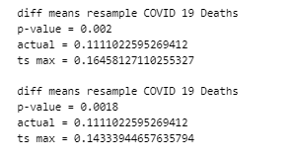
Hypothesis testing
Conduct a test on your hypothesis using one of the methods covered in Chapter 9.
Conclusions of Hypothesis testing and comparing resampling versus permutations:
The week_start date filter has been applied on death_count variable to extract 2 dataframe [ deaths_first_range and deaths_second_range ]
Using resampling instead of permutation has very little effect on the results.
Both the models [resampling and permutations] are based on slightly difference assumptions, and in this example, there is no compelling reason to choose one or the other.
But in general p-values depend on the choice of the null hypothesis;
Also, the different models can yield very different results.

Slide 20
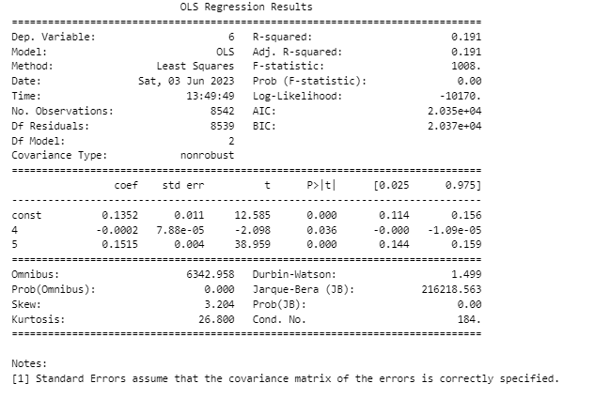
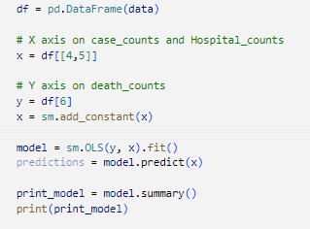
Regression Testing
For this project, conduct a regression analysis on either one dependent and one explanatory variable, or multiple explanatory variables (Chapter 10 & 11)
smf.ols takes the formula string and the DataFrame, death_counts from COVID 19 datasets and returns an OLS object that represents the model. The name ols stands for “ordinar least squares."
The fit method fits the model to the dataset and returns a RegressionResult object that contains the results.

Slide 21

References
GITHUB Repository : https://github.com/santoshgithub100/DSC530_TermEndProject
PMF and CDF: https://towardsdatascience.com/probability-distribution-functions-demystified-a6e882759af3
Multiple and Single Regression: https://www.w3schools.com/python/python_ml_multiple_regression.asp
Python Histograms, Plots and Distributions: https://mode.com/python-tutorial/python-histograms-boxplots-and-distributions/

Slide 22

BELLEVUE UNIVERSITY : DS530 Data Exploration and Analysis

